Slide 1

CLIP:Learning Transferable Visual Models From Natural LanGuage SuperVision
PRESENTED BY:- SAGAR KHUTETA
COURSE:- CSE 705

Slide 2
INTRODUCTION AND MOTIVATION

Slide 3
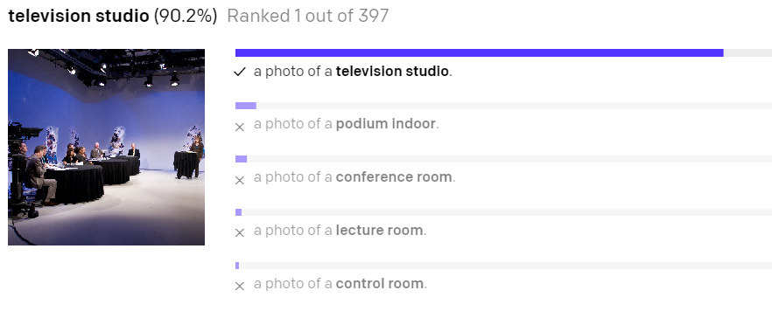
INTRODUCTION
The current state-of-art computer vision algorithms are trained to predict a fixed set of objects. Although, we can train the algorithm for new set of objects, the process is computationally expensive and cumbersome.
The authors of this paper demonstrate that simple pre-training of task of predicting which caption goes with which image is a much better approach.
Notes:
2) The time for training million images which took accelerator years 5 years ago now take accelerator days.
3) The experiment done in critical zone observatory on imagenet achieved an accuracy of 11.5% which is less than common Computer vision approaches we see.

Slide 4
MOTIVATION
Pretraining methods learning from raw text have revolutionized NLP over the last few years.
The scale of computing, model capacity and data have improved tremendously.
Natural Language supervision for image-representation has had poor performance as compared to image-classification models.
Large quantities of data of image text pair publicly available on the internet.
Notes:
2) The time for training million images which took accelerator years 5 years ago now take accelerator days.
3) The experiment done in critical zone observatory on imagenet achieved an accuracy of 11.5% which is less than common Computer vision approaches we see.

Slide 5
APPROACH
CONTRASTIVE LEARNING
HOW DOES THE PRETRAINING WORK
CREATE DATASET CLASSIFIER FROM LABELED TEXT AND USE FOR ZERO-SHOT PREDICTION

Slide 6
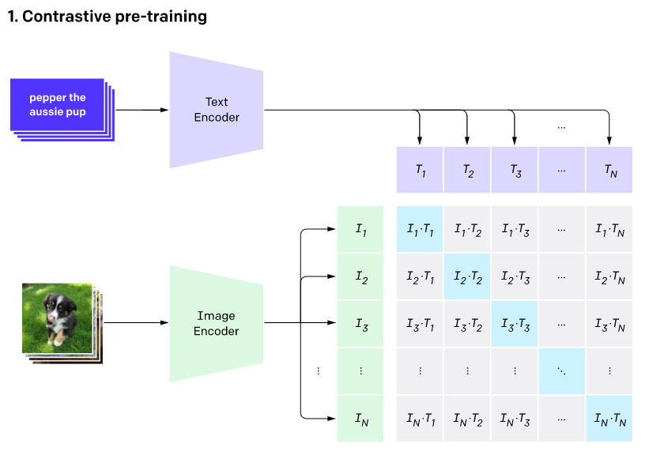
CONTRASTIVE LEARNING
This is done with the help of dataset created by OpenAI which has 400 million text image pairs.
The text-encoder used is a masked self-attention transformer and the image encoders used are ResNet50 with modification and vision transformer.
The images and texts are passed through the respective encoders and a similarity matrix is created with these vectors.
In the similarity matrix we try to maximize cosine similarity of the N real pairs and minimizing the cosine similarity of the remaining N² – N pairs.

Slide 7
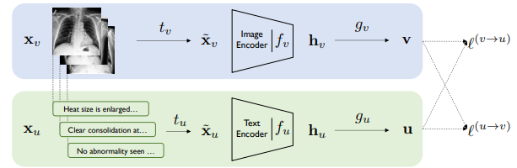
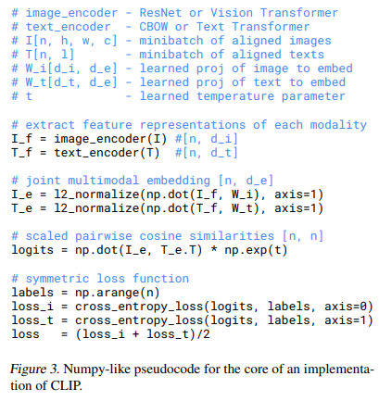
HOW DOES THE PRETRAINING WORK?
This paper is heavily inspired from the convirt paper from Stanford university.
The image is resized and a random cropping is done and it is passed through the encoder.
The loss function used here is cross-entropy loss and using this loss value we get the desired

Slide 8
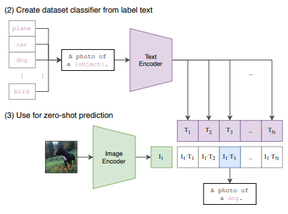
CREATE DATASET CLASSIFIER FROM LABELED TEXT AND USE ZERO-SHOT PREDICTION
In this process, we will use an unseen dataset like CIFAR10 for zero-shot prediction.
Firstly, the labels will be prompt-engineered as those labels give a better result.
The labels are then passed through the pre-trained text encoder to get text embeddings
Finally, the images will be passed through the image encoder and the image embedding will be used with all text-embeddings.
The one with best score will be our output.
Notes:
1) The dataset will have many images of same type. Let’s say a photo of a dog and a sketch of a dog. We will average them out before representing it as a vector and this improves accuracy.

Slide 9
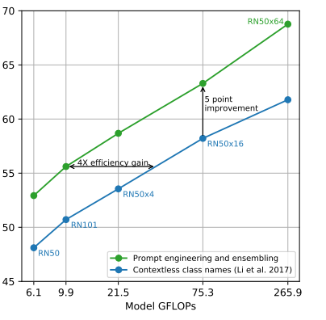
PROMPT ENGINEERING AND ENSEMBLING NEED AND RESULT
Polysemy Problem: Construction crane and crane(bird) are present in imagenet dataset. Adding more text like This is a Crane bird can help us solve this problem.
For OCR dataset putting quotes around number improved performance.
Ensembling prompts across embedding space also increased the performance.

Slide 10
EXPERIMENTS AND RESULTS

Slide 11
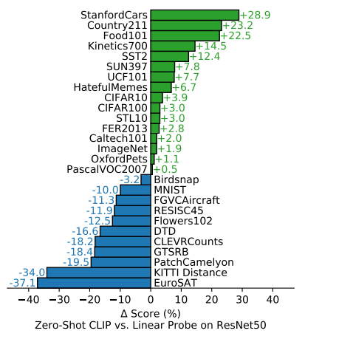
ZERO-SHOT CLIP VS LINEAR PROBE ON RESNET
ResNet50 is fine-tuned on all of the 27 datasets.
We observe that the scores are low for datasets like EuroSAT and KITTI Distance and high for StanfordCars and Country211 Datasets as compared to linear probe on resnet50.
On an average Zero-Shot CLIP performs better than fine-tuned resnet on these datasets.

Slide 12
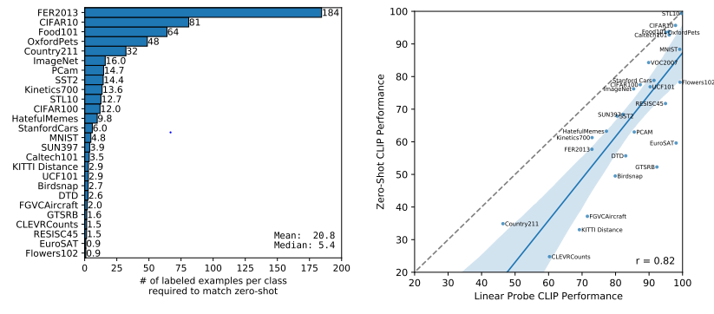
ZERO-SHOT CLIP VS LINEAR PROBE CLIP ON LABELED EXAMPLES

Slide 13
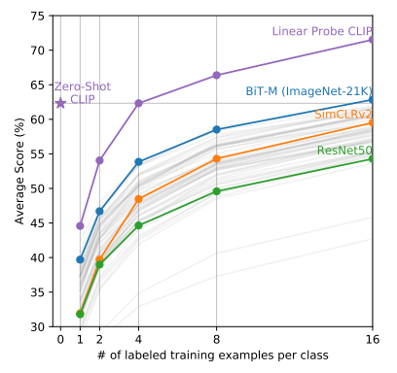
ZERO-SHOT CLIP VS OTHER TRAINED MODELS ON LABELED EXAMPLES
As we can see that the performance of CLIP is better performing than other models when we provide limited number of labeled training data.
We also see an anomaly where the Linear Probe CLIP is less accurate than Zero-Shot CLIP for up to 4 labeled data.

Slide 14
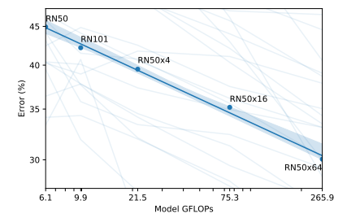
ZERO-SHOT CLIP SCALING

Slide 15
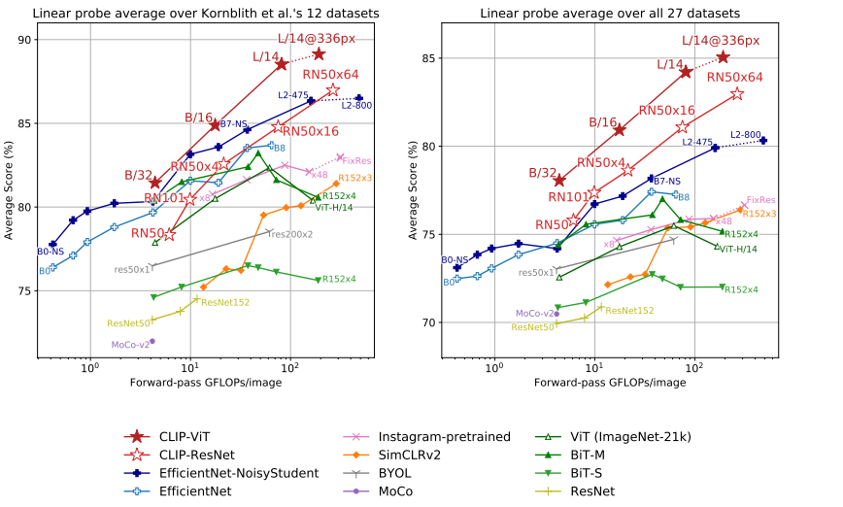
LINEAR PROBE OVER OTHER DATASETS

Slide 16
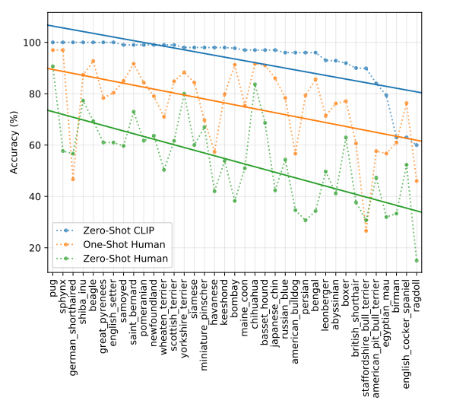
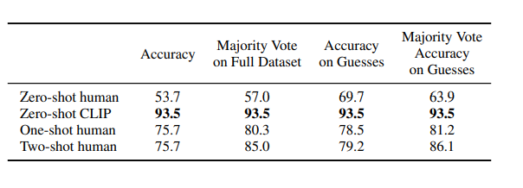
ZERO-SHOT CLIP VS HUMANS

Slide 17
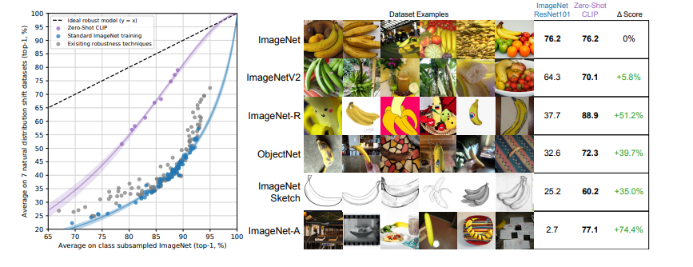
ZERO SHOT VS RESNET ON DISTRIBUTION SHIFT

Slide 18
ZERO SHOT VS RESNET ON DISTRIBUTION SHIFT

Slide 19
LIMITATIONS

Slide 20
LIMITATIONS
CLIP does not perform well on abstract and complicated tasks such as counting the number of objects in an image or how close 2 objects are in the image.
It also struggles on fine-grained classification such as telling difference between car models and flower species.
CLIP also still has poor generalization to images not covered in the pretraining dataset. E.g MNIST
The prompt engineering sometimes require trial and error to perform well.

Slide 21
BIAS

Slide 22
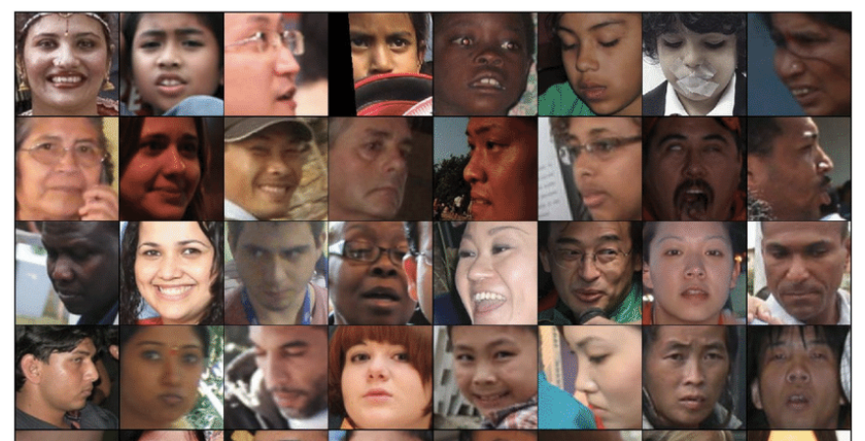
BIAS
They have used the fairface dataset for this purpose.
It consists of people of 7 different races and 2 genders.
In addition to the above races they add 4 non-human classes(animal, gorilla, chimpanzee and orangutan) and 3 crime-related classes(Thief, criminal and suspicious person).

Slide 23
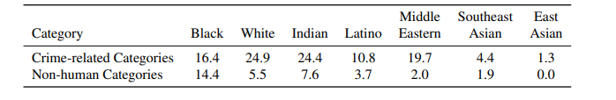
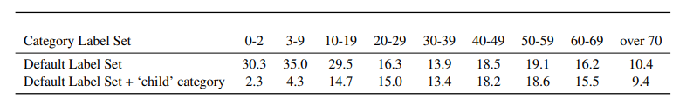
BIAS

Slide 24
KEY TAKEAWAYS
CLIP is highly efficient. It learnt from unfiltered,varied and highly noisy data and still gives us excellent results.
CLIP is highly flexible and general. While CLIP’s zero-shot OCR performance is mixed, its semantic OCR representation is quite useful.
It does have certain limitations but this approach has several benefits and can be pursued for further research.

Slide 25
REFERENCES
CLIP Blog Post:- https://openai.com/blog/clip/#rf1
CLIP Model Card:- https://github.com/openai/CLIP/blob/main/model-card.md
https://www.youtube.com/watch?v=fQyHEXZB-nM

